Slide 1


Team 28: Guitar Entertainment System
Bi-Weekly Update 1 Rishabh Ruikar, Monte Martin III, Rawan Ibraheem Sponsor: TA
Notes:
Michelle

Slide 2
Project Summary
Problem Statement: Current guitar amplification and sound modification systems lack the integration of modern technology and user-friendly control methods for those with limited experience.
Solution proposal: Develop a high-tech guitar sound system with an amp, pedals, and a bluetooth app, to allow to the user to more seamlessly integrate and customize the sound system to their liking.
Notes:
Kyle

Slide 3
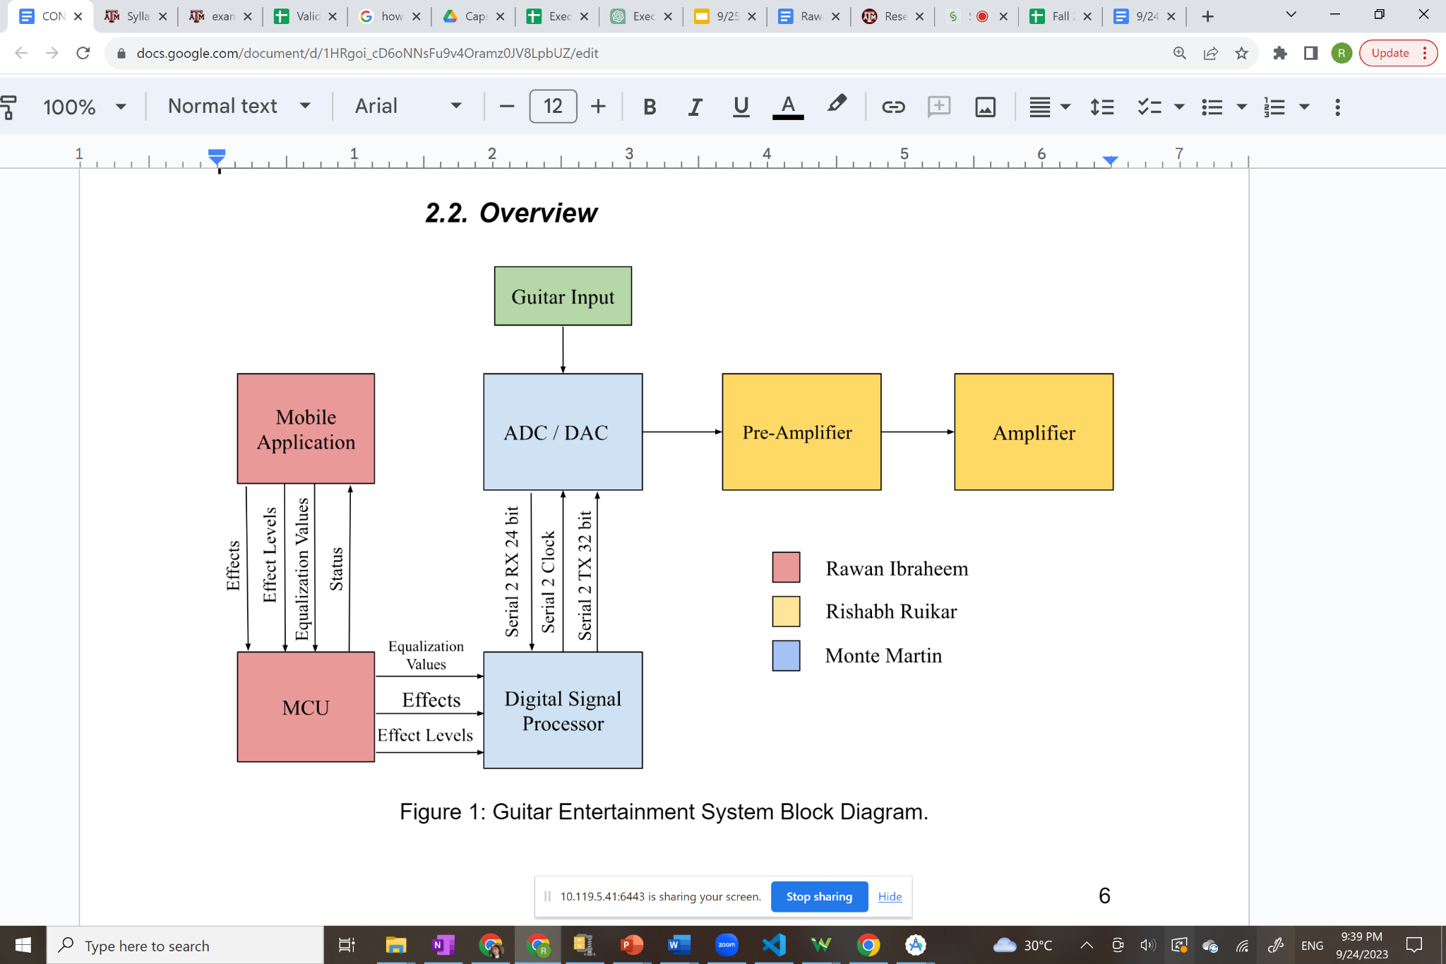
Project/Subsystem Overview (45 seconds)
Notes:
Eric

Slide 4
Subsystem Characteristics
Amplifier
Pre-amp
Amplify low-level signals, matches impedances between source and mixing device, minimizes noise
Amplifier
Boosts the power of the “conditioned” signal to be able to drive speakers to sufficient volume while maintaining clarity at high output levels.
Pedal System
ADC - Converts the analog input signal into a digital signal and transmits it to the DSP
DSP - takes in the digital signal and data from the ESP32 to implement effects, then outputs the changed digital signal.
DAC - Converts the changed digital signal from the DSP into an analog signal to be sent to the amplifier
Bluetooth App
Android application developed in Android Studio
Application communicates with ESP32 using Bluetooth Low Energy (BLE)
Application is used to control guitar sound effects and adjust the levels of the effects from a mobile device wirelessly

Slide 5
Major Project Changes for 404
Amplifier
Reduce size of board
Fix PCB errors that persisted in 403
Create a housing for both the amplifier as well as the pedal system (either 3D printed or wood)
Incorporate an on/off switch within the housing
Pedal System
Use an ESP32 Module instead of a chip
Change routing for ground and power planes to improve reliability and eliminate unnecessary traces
STM32 evaluation board instead of a chip depending upon what design changes are chosen
Bluetooth App
Implement error handling for when Bluetooth is not enabled on mobile devices to prevent crashes
Implement status updates to ensure sound effects are applied, and that device can connect to MCU and DSP
Notes:
Eric

Slide 6
Project Timeline
Amplifier
New boards with incorporated changes have been sent to manufacturing (1/23)
PCB components still need to be bought (will be done by 1/29)
Pedal System
Settle on design changes and redistribution of workload by 1/30
Design new PCB and order it by 2/6
Bluetooth App
Last step is to implement error handling during integration of subsystems
All
Begin housing design process by 2/25
Have the housing 3D printed by the first week of April
Notes:
Eric

Slide 7
Subsystem 1 (Amplifier)
Rishabh Ruikar
Accomplishments since 403 5 hrs of effort | Ongoing progress/problems and plans until the next presentation
New boards have been sent to manufacturing (delivery time approx. 1 week) | PCB components will be ordered New boards will be soldered and ready for testing

Slide 8
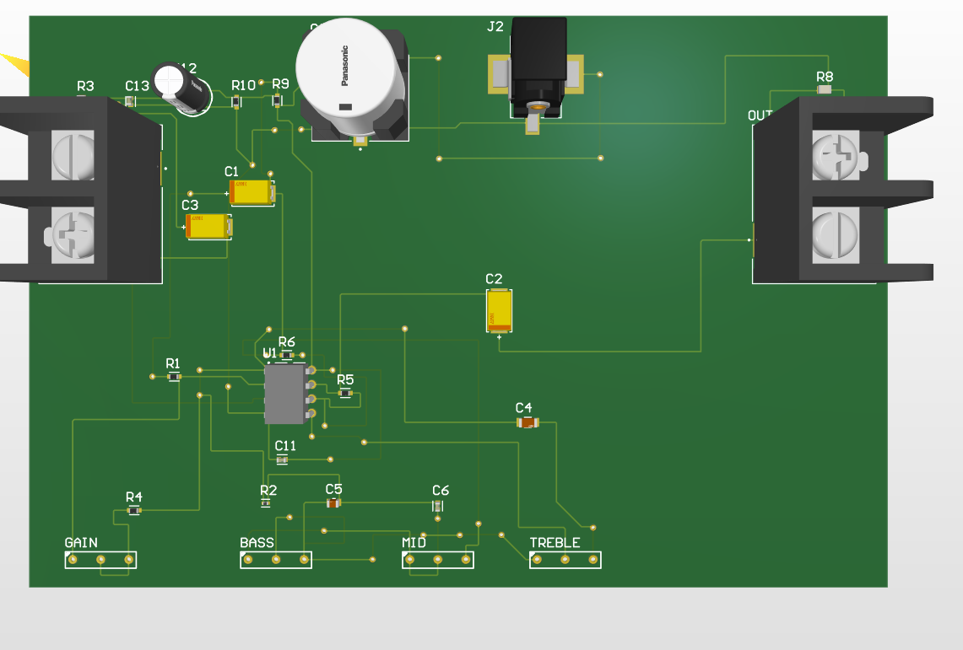
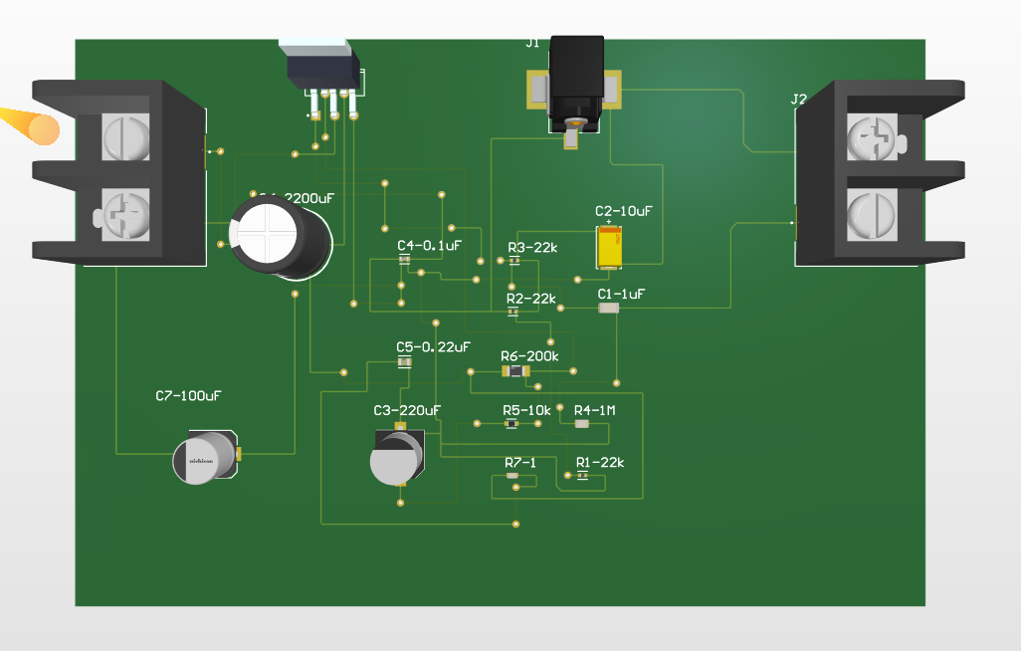
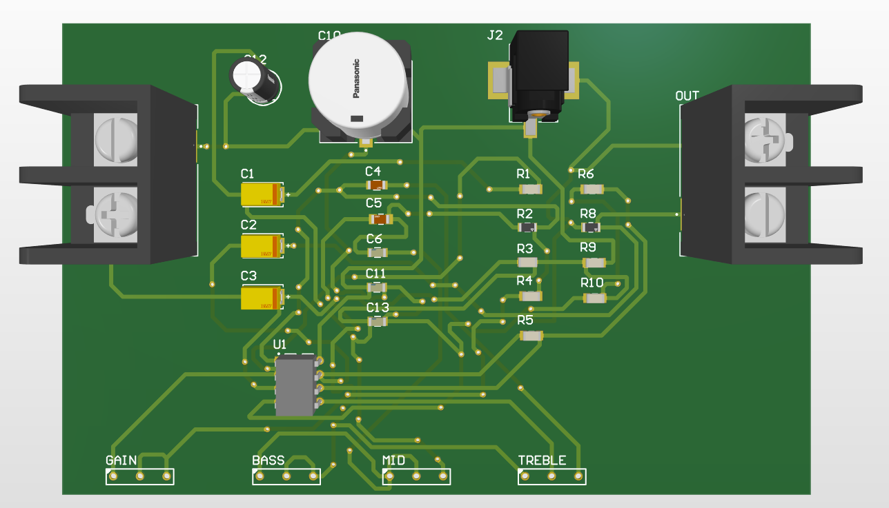
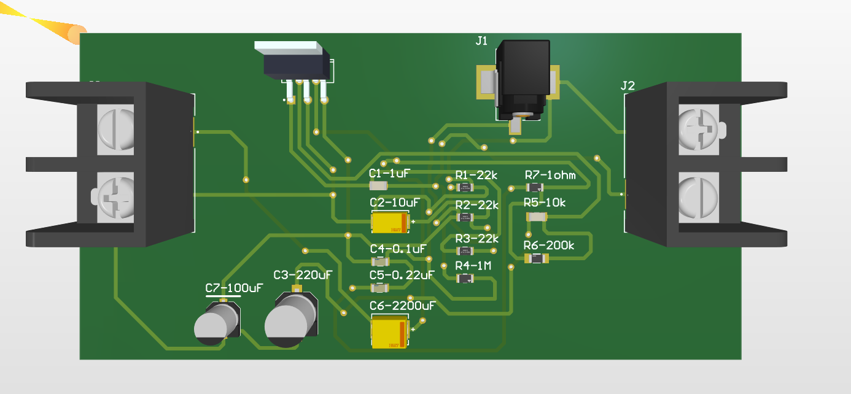
Subsystem 1 (Amplifier)
Rishabh Ruikar
Preamplifier
Amplifier
Was unable to create a working design in 403 due to power jack polarities being reversed on PCB, causing op-amp to release “magic smoke”
PCB components was also microscopic, which caused shorts between pins
Previous trace widths (10mil) were also insufficient for speaker signals to pass through

Slide 9
Subsystem 2 (Pedal System)
Monte Martin III
Accomplishments since 403 40 hrs of effort | Ongoing progress/problems and plans until the next presentation
Tested and validated the functionality of the practical filter for the ADC. | Determine possible design changes to improve feasibility and to more evenly distribute the workload Design in altium the new PCB incorporating design the design changes agreed upon and send it out for fabrication Determine the functionality of the DAC

Slide 10
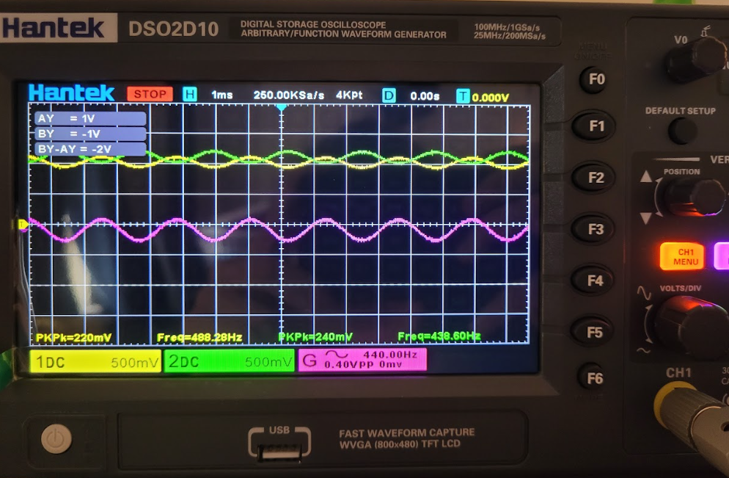
Subsystem 2 (Pedal System)
Monte Martin III
Oscilloscope readings for the practical filter showing that it converts a single ended source into a differential signal. Will be confirmed using the equipment in the FEDC.

Slide 11
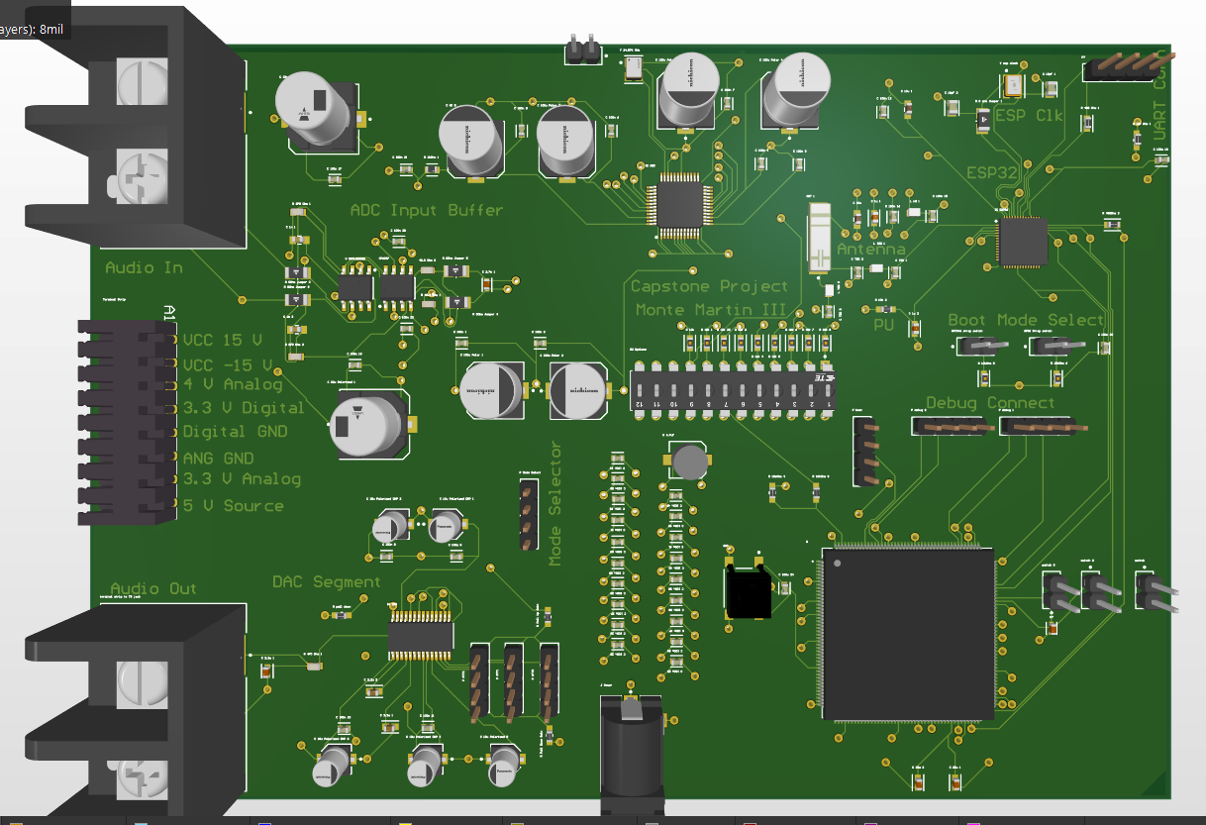
Subsystem 2 (Pedal System)
Monte Martin III
Changes: using an ESP32 Module instead of a chip, change values of two resistors from 560 to 270 Ohms, use DC jacks for 4.0V and 3.3V power nets, and terminal plugins for 15V and -15V nets. Change several components and implement switches instead of jumpers.
Possible Changes: Using a STM32 evaluation board instead of a chip for ease of use and simplicity.
The practical filter is currently working, but unable to determine of the ADC is working due to not having working code for the DSP/STM32. DAC circuit doesn’t have any visible issues but cannot be tested until there is a working DSP to send it PCM audio data.

Slide 12
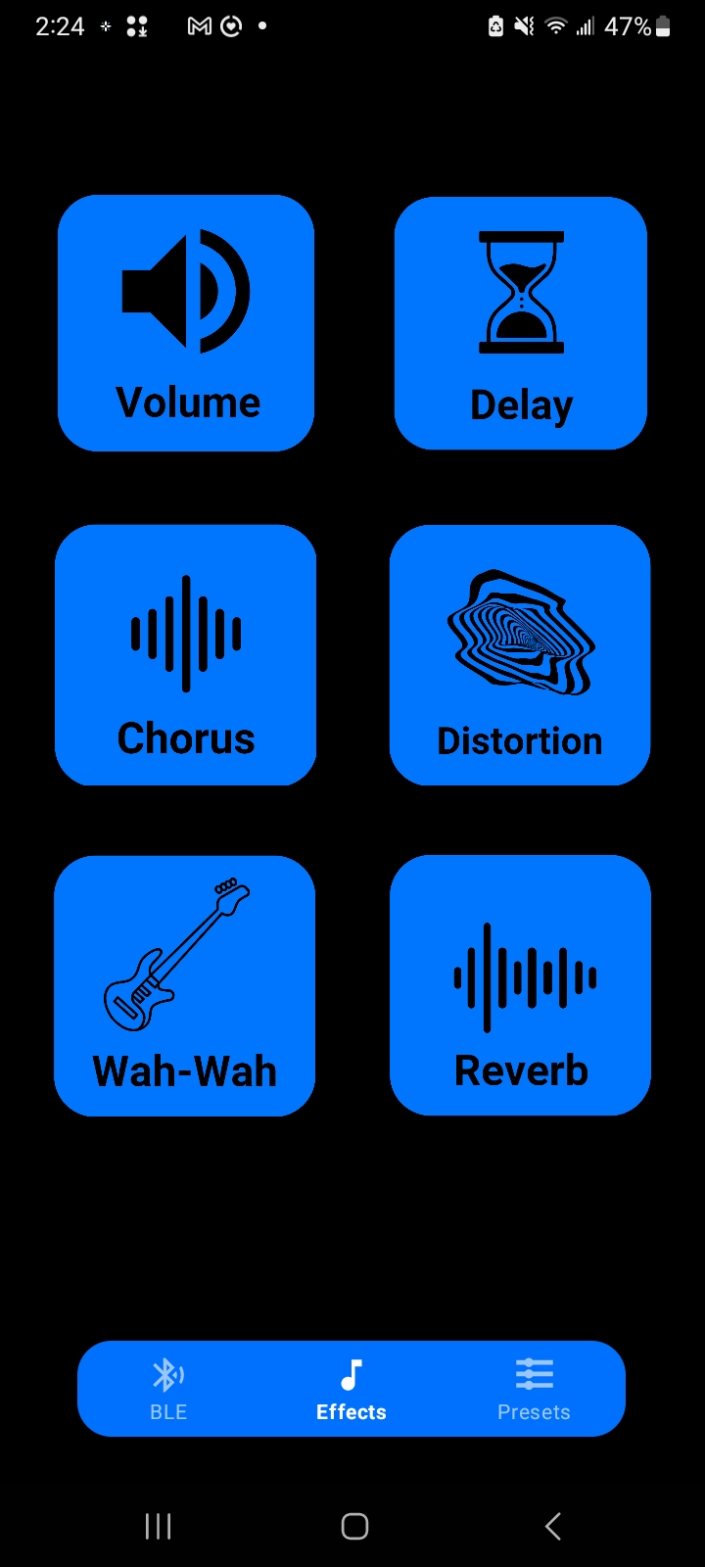
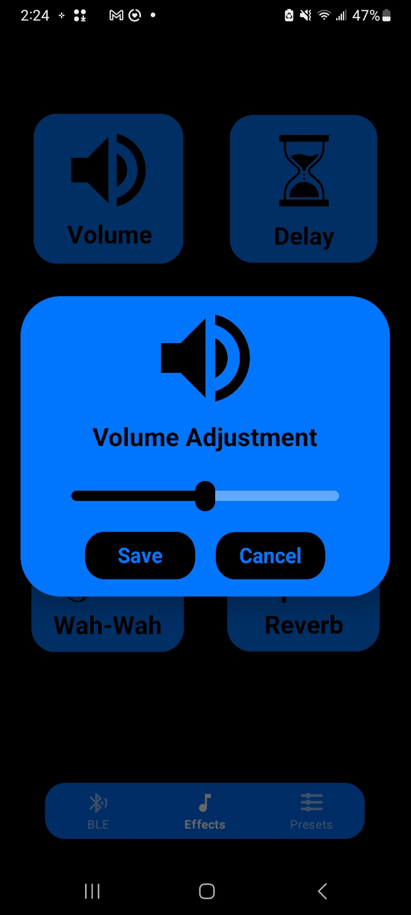
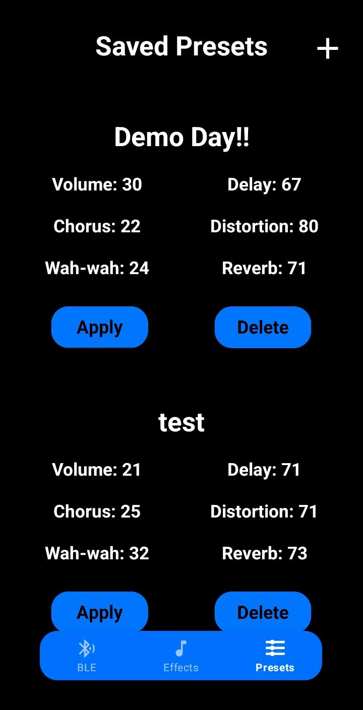
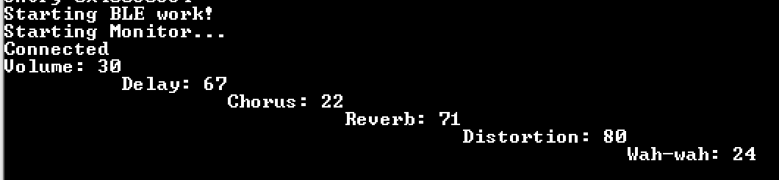
Subsystem 3 (Bluetooth App)
Rawan Ibraheem
To the left is an example of a preset being applied. The updated effects are shown in the terminal connected to the ESP32.

Slide 13
Subsystem 3 (Bluetooth App)
Rawan Ibraheem
Accomplishments since 403 <1 hrs of effort | Ongoing progress/problems and plans until the next presentation
Uploaded the most recent version of application to Github repository to ensure files do not get lost | Program the STM32 to implement received sound effect adjustments from the ESP32. STM32 will be programed using the STM32Cube IDE Must be able to receive signals from ESP32 and translate that information into sound effects

Slide 14
Parts Ordering Status (30 seconds)
(Pedal System): Already have STM32 Evaluation board, several parts are already acquired due to ordering extra parts in 403. Any needed parts will be ordered when the PCB for the pedal system is ordered. Expected to have all parts and the PCB by 2/13
(Amplifier): PCBs have been sent to manufacturer (1/23). Will be consulting with Professor Nowka and TA if needed to discuss additional funding for PCB components (resistors, capacitors, etc.). Parts order will be placed at latest by 1/29
Notes:
Michelle

Slide 15
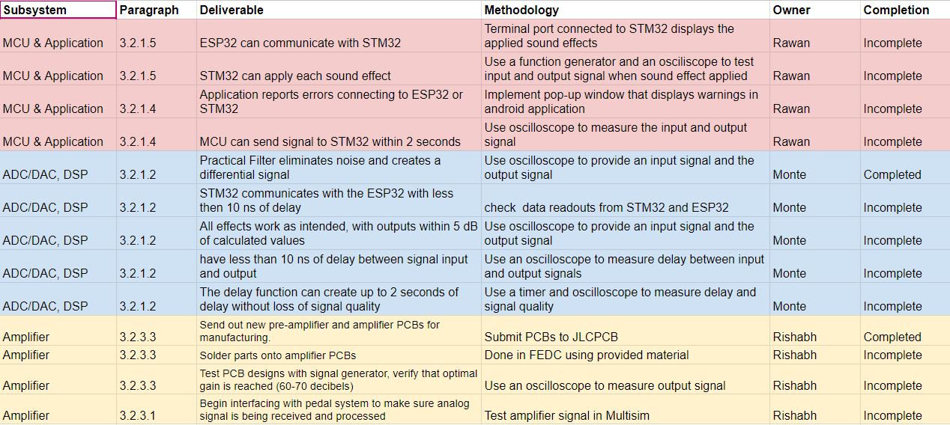
Validation Plan
Notes:
Michelle

Slide 16
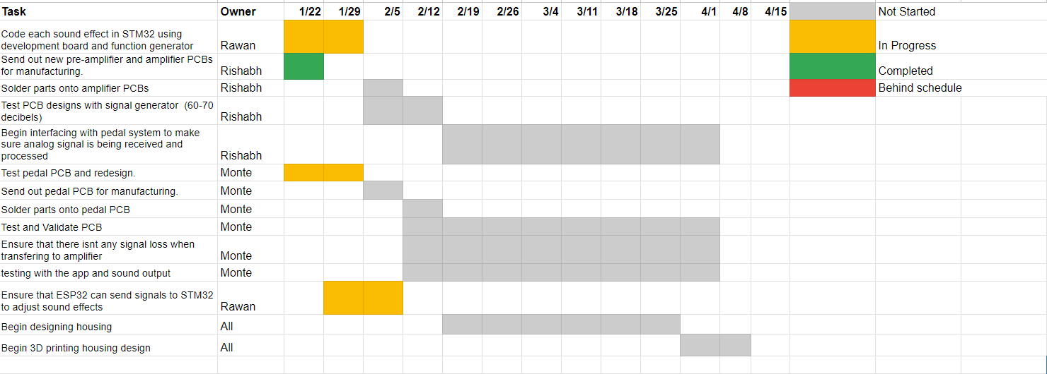
Execution Plan

Slide 17
Thank you for your time!

